Slide 1
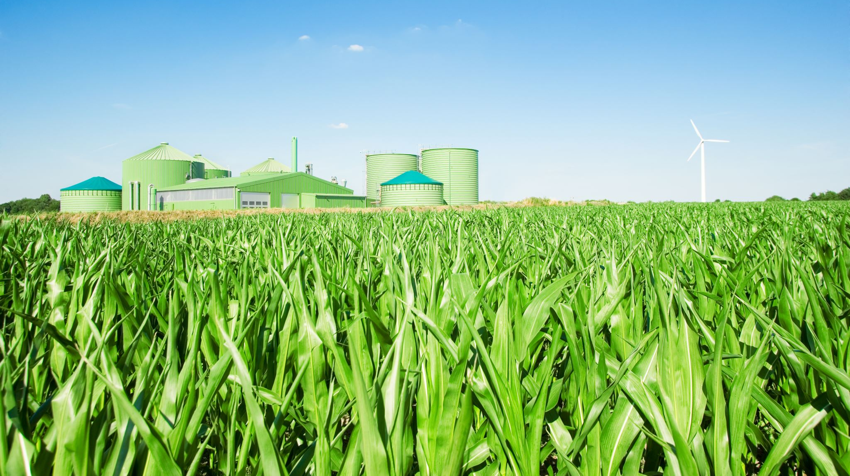
Wildlife Conservation (Core29)
Stuart Keith, Matthew Holmes, Alistair McCulloch

Slide 2
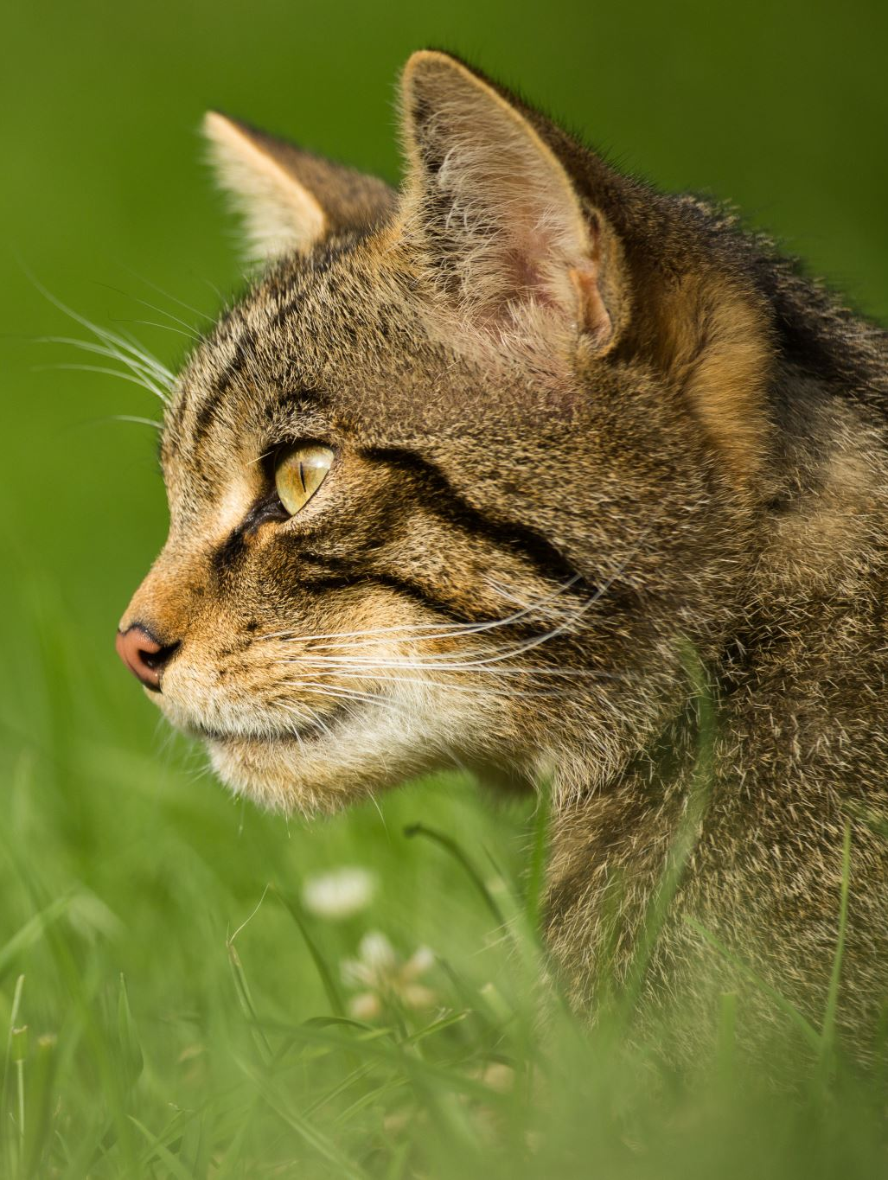
Our Task
Our challenge presented to us by Core29 was to develop an intelligent wildlife tracking application.
This application’s purpose is to allow users to submit, categorise, and analyse wildlife data. This will focus on streamlining data collection, enhance categorisation accuracy, and provide insights through visualisations or predictive analysis.

Slide 3
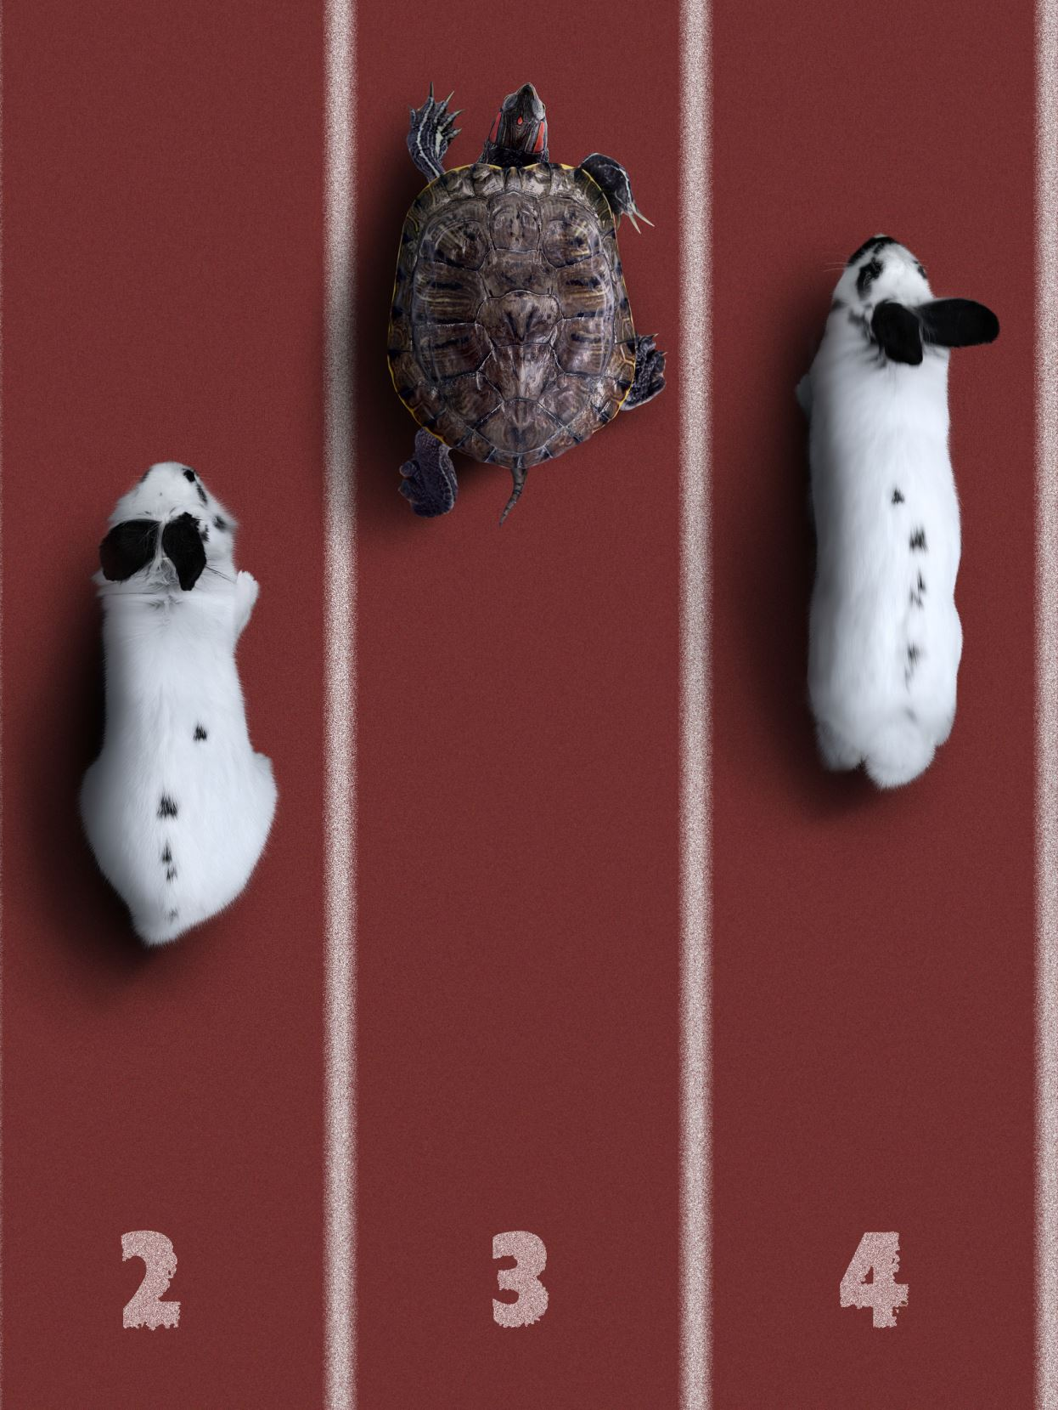
Our Solution
We as a team have developed a web-based application featuring the following:
A login/signup page
A page for users to add and filter through data to a list
A photo scanner to recognise an animal using an image uploaded by the user (Further implementation needed)

Slide 4
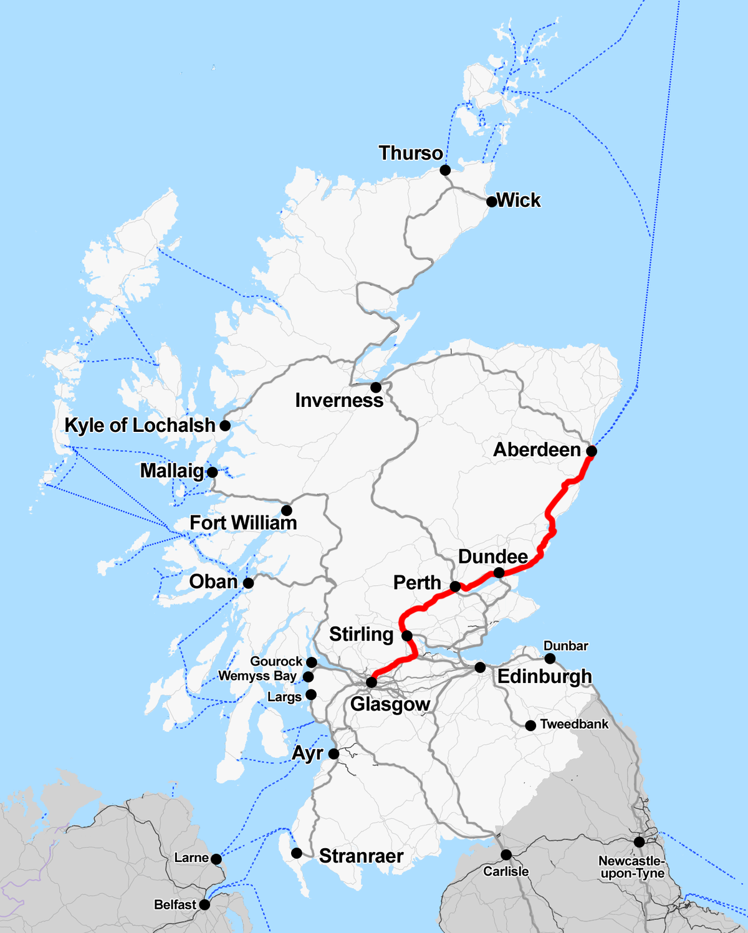
Location Data
Location is found using the integrated geolocation in browsers that support it, this returns the users Longitude and Latitude
Geoapify Location Platform is the API we chose to use. Using this API and the user's data we used the APIs reverse geolocation to get a general user Location
Google maps API would’ve worked but they wanted credit card information

Slide 5

AI for species Identification (Further work Needed)
Use of Javascript libraries P5.js and ML5.js
ML5.js would process and identify based on the image
P5.js would display the image on the page
Mobile Net is a lightweight dataset we would use, not the most advanced but it’s free

Slide 6
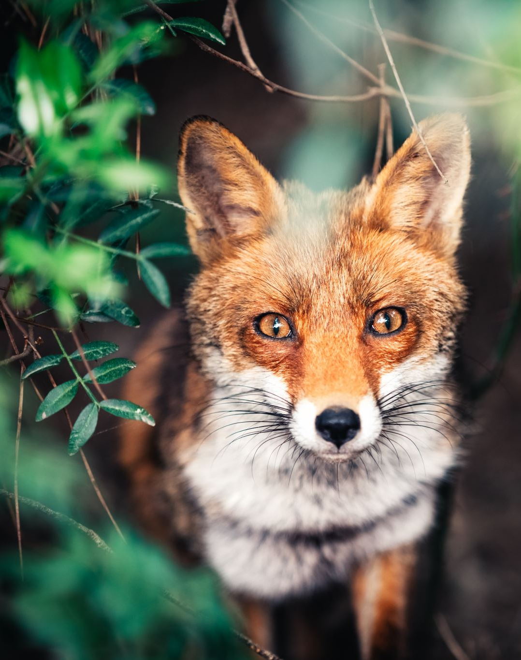
Practical Demonstration
We will now give a short demo of the project so far.

Slide 7
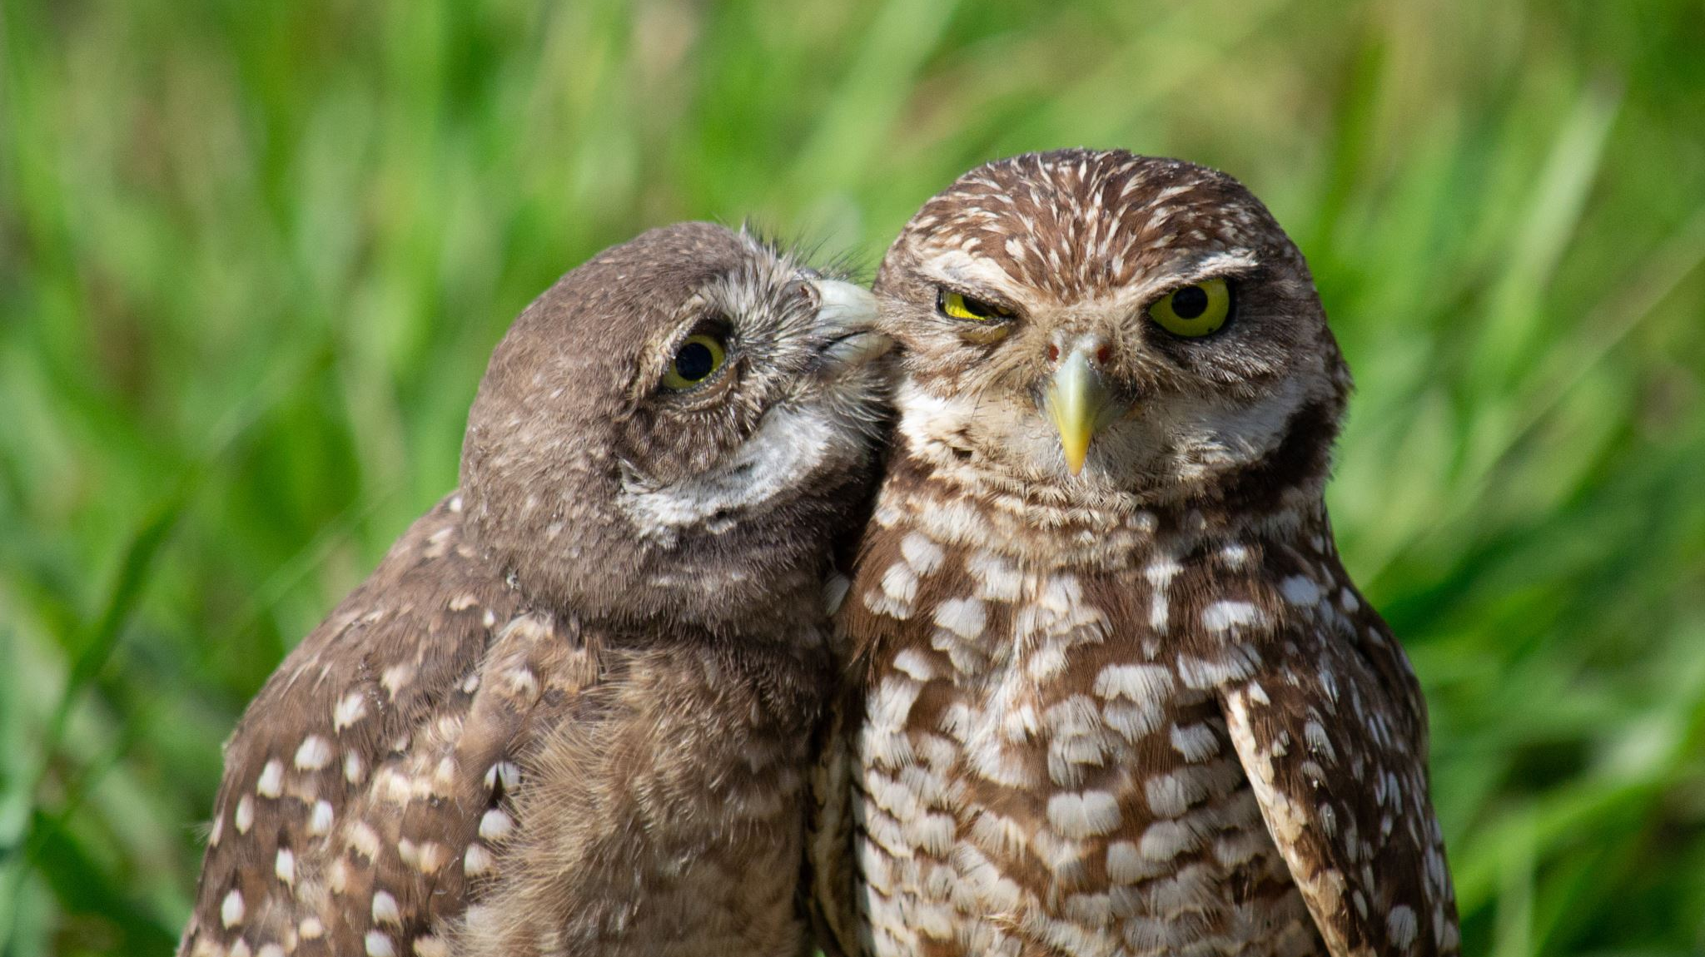
You can help researchers with your data submissions!

